Slide 1


SMART INDIA HACKATHON 2024
Problem Statement ID - 1740
Problem Statement - Development of map-matching algorithm using AI-ML techniques to distinguish vehicular movement on highway and service road
Theme - Smart Automation
PS Category - Software
Team Name – Tech Hawks’

Slide 2
Idea / approach
Tech Hawks’
challenges
Start with collecting GNSS data and Electronic Map.
Train the LSTM Model with a given Training Examples and then use further.
Diffused coordinates from GNSS data is filtered by using LSTM Model.
LSTM Model and SSR Service will also help to provide precise Co-Ordinates tracing the missing coordinates in case of breakage of GNSS data.
Extract features like Co-Ordinates, Speed, Heading, and type of road.
Implement the OSRM Model to match the vehicle’s filtered coordinates to the correct road segment. Once the data is cleaned and feature extraction is complete, train an ML model using Scikit-Learn, Py-Torch and Tensorflow Keras.
Extract features like Velocity, Route Segments and Type of Route.
When the model is performing optimally, deploy on Netlify.
The model can now be used for real-time inference, receiving live GNSS data and outputing the type of road (highway or service road).
This solution will support applications like GNSS-based tolling by providing precise information on the vehicle’s movement, ensuring accurate toll calculations.
Making Diffused and Breaked data continuous
By using the LSTM and SSR Model which is use to precise the diffused Coordinates and predict expected road for breakes.
Precise Map Matching
By using the OSRM we are matching the map from the given Electronic Map.
Comparing E-map’s pixels with real time coordinate
OSRM has a inbuild function which converts E-map pixel into latitude and longitude and compare with real time coordinate.
Improper plotting of coordinate on the map
We have an algorithm that calculates how close candidate’s road segment is to the GPS point by path smoothing method.
Classification of Highways and Service roads
We have used Classification Model of Supervise Machine Learning in our ML Code for classifying the road segment to Highway and Service Road.

Slide 3
Tech Hawks’
L.S.T.M. Precision Model
O.S.R.M. Map Matching
Long Short Term Memory Model
[OSRM is open Source model and provide real time map matching]
GPS Signal
LSTNM model for refining GPS
OSRM Model
{Having E – Map for align GPS data}
Raw GPS Data collection
Proximity Search
{Identify Road Segment for each co-ordinate}
DATA PREPARATION
Data preprocessing
Feature Engineering
Sequence Creation
Distance Calculation
Calculates how close candidate’s road segment is to the GPS point for Path Smoothing
Cost Calculation
Calculates factors such as distance, road type, and other relevant attributes
Segment Selection
Model Design
First LSTM layer
Second LSTM layer
OUTPUT
Path Assembly
Dens Layer
Output
Segments of Route
Type of Route
Velocity

Slide 4
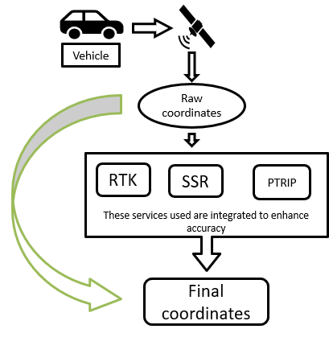

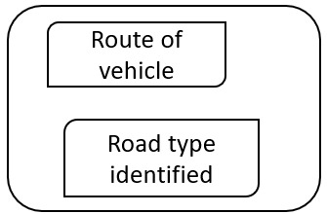
TECHNICAL APPROACH
Tech Hawks’
TECHNOLOGY STACK:
ML : Python.
Model selection and training: Scikit-Learn, Py-Torch, Tensorflow Keras
Map matching : O.S.R.M. , Python
GNSS data handling: L.S.T.M.
Data pre processing : Pandas.
Deployment : Netlify
Data collection
LSTM
OSRM
Database
Classification
Prototype Model
Output
Model Deploy

Slide 5
IMPACT AND BENEFITS
Tech Hawks’
Benefits
Precise Road Type Classification (highway vs service road) in real-time.
Scalable Globally with adaptability to different geographic regions.
Ensures Driver Safety by guiding vehicles appropriately based on road type.
Facilitates Regulatory Compliance for GNSS-based tolling and road usage monitoring.
Accurate Vehicle Tracking using GNSS data for real-time location updates.
Supports Smart City Applications like tolling, congestion charging, and traffic management.
Cost Efficiency by reducing infrastructure and operational expenses.
Resilience to Poor GNSS Signals and handling of noisy or intermittent data.

Slide 6
RESEARCH AND REFERENCES
Tech Hawks’
References:
L.S.T.M: LSTM predicts accurate road sequences by learning from GPS data.
For Details : Click Here
Scikit-Learn: Simple and efficient tools for predictive data analysis.
For Details : Click Here
O.S.R.M: OSRM performs fast and accurate map matching using OpenStreetMap data.
For Details : Click Here
TRANING DATA : Next Generation Simulation (NGSIM) Open Data
For Details : Click Here
!! THANK YOU !!

